Slide 1
AUTOMATION PROJECT
Analysis of trending-video history on YouTube

Slide 2
Contents
Main goal:
Analyse trending-video history on YouTube
Main questions:
Which video categories trended most often?
How were they distributed among regions?
What categories were especially popular in the United States? Were there any differences between the categories popular in the US and those popular elsewhere?
Project can be found here: Project Link

Slide 3
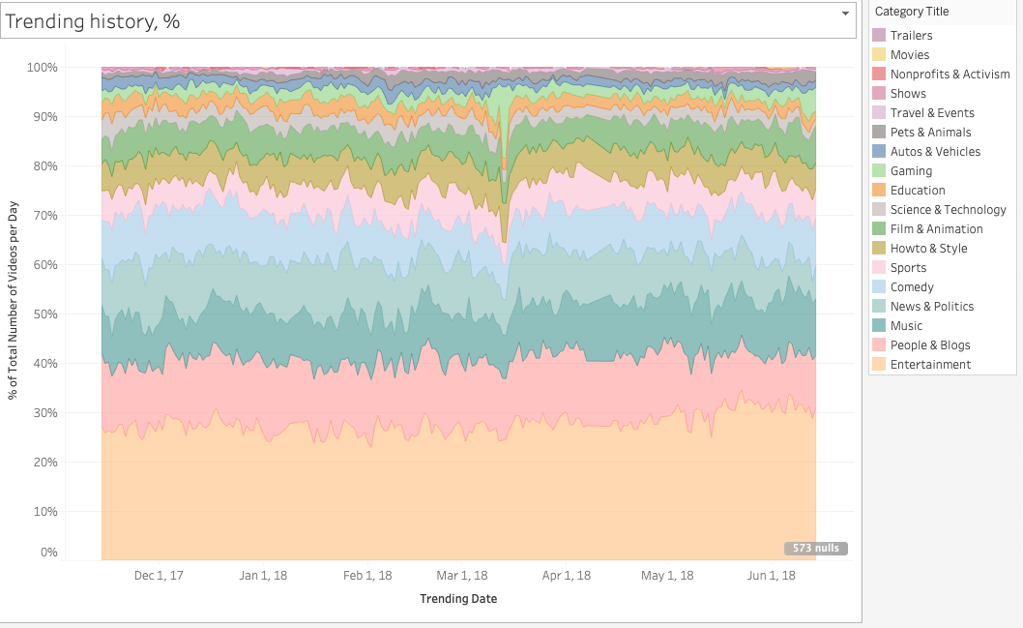
Which video categories trended more often?
The most popular categories have stayed the same throughout last 2 years:
Entertainment (26-31%)
People & Blogs (10-14%)
Music (9-12%)
News & Politics(9-11%)
Comeby(8-10%)

Slide 4
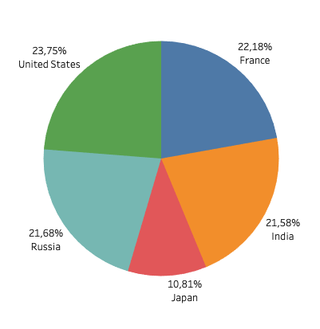
How were they distributed among regions?
US, France, Russia and India seem to have similar share of YouTube market share, while Japan has smaller.

Slide 5
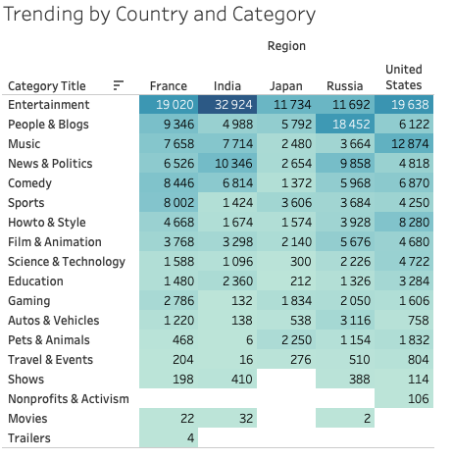
What categories were especially popular in the United States? Were there any differences between the categories popular in the US and those popular elsewhere?
In US the most popular categories are “Entertainment” and “Music”.
“Music” category is not as popular in other regions. It may be due to less strict regulations for downloading and listening on pirate services.
Popular categories vary from region to region. In India “Entertainment” is way ahead of other categories, while in Russia ”People and Blogs” seem to be more popular.

Slide 6
Conclusions
“Entertainment” category is the most popular one in all regions;
In US market “Music” category is much more popular than in other regions
All regions have different popular categories, there are specifics that need to be considered while working with these markets.

